Slide 1
2020SM1 Workshop Week 9 Exercises 1-4
comp20008

Slide 2
1 – What is classification? What is regression? What is the difference between the two:
Answer:
Classification: Attempting to map from input variables (x) to discrete or categorical output variables (y)
Regression: Attempting to map from input variables (x) to numerical or continuous output variables (y)
Main difference: attempting to predict a discrete category vs a continuous number

Slide 3
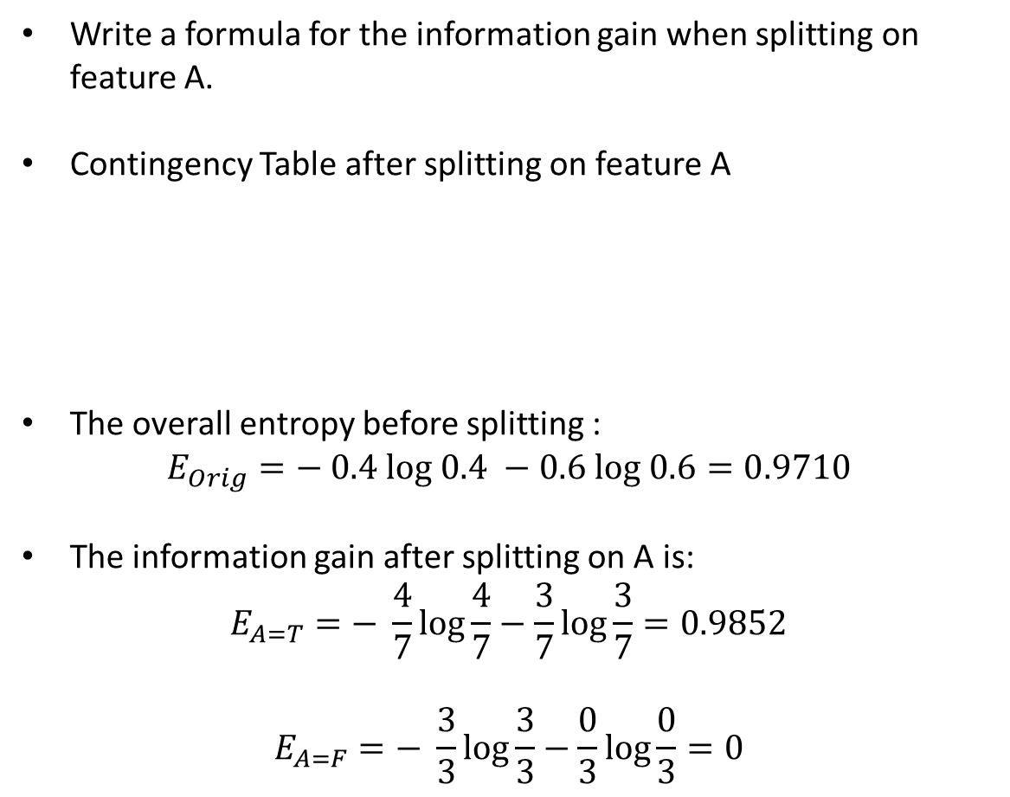

2- Consider the following data set for a binary class problem and consider building a decision tree using this data.
Write a formula for the information gain when splitting on feature A.
Contingency Table after splitting on feature A
The overall entropy before splitting :
$$E_{Orig}=− 0.4 log 0.4 −0.6 log 0.6=0.9710$$
The information gain after splitting on A is:
$$E_{A=T}=− \frac{4}{7}log\frac{4}{7}−\frac{3}{7}log\frac{3}{7}=0.9852$$
$$E_{A=F}=− \frac{3}{3}log\frac{3}{3}−\frac{0}{3}log\frac{0}{3}=0$$
Feature A | Feature B | Class Label
T | F | +
T | T | +
T | T | +
T | F | -
T | T | +
F | F | -
F | F | -
F | F | -
T | T | -
T | F | -
 | A = T | A = F
+ | 4 | 0
- | 3 | 3
$∆ = E_{Orig}− \frac{7}{10}E_{A=T}−\frac{3}{10}E_{A=F}=0.2813$

Slide 4
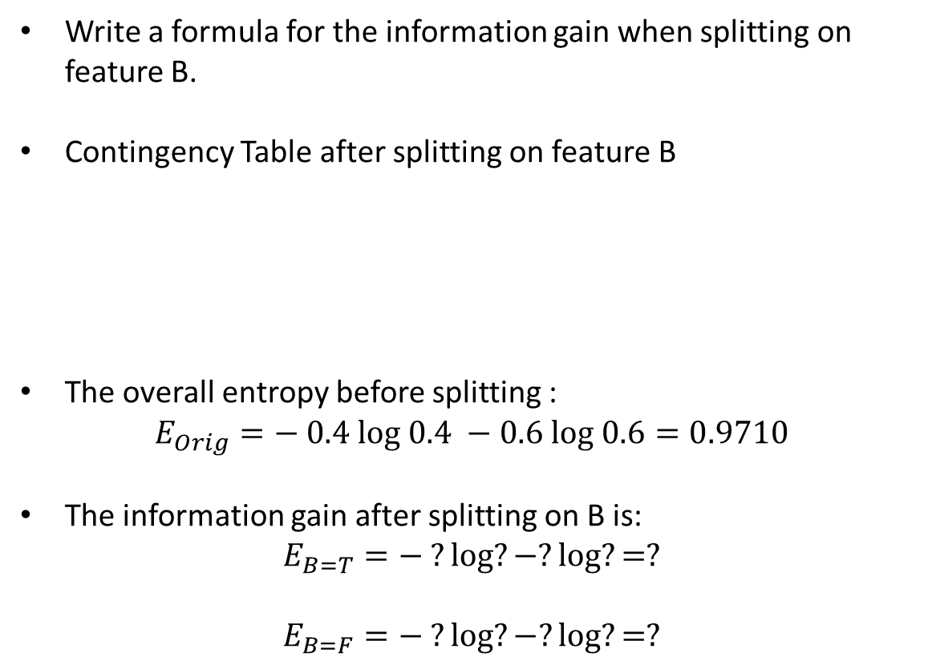

2- Consider the following data set for a binary class problem and consider building a decision tree using this data.
Write a formula for the information gain when splitting on feature B.
Contingency Table after splitting on feature B
The overall entropy before splitting :
$$E_{Orig}=− 0.4 log 0.4 −0.6 log 0.6=0.9710$$
The information gain after splitting on B is:
$$E_{B=T}=− ?log?−?log?=?$$
$$E_{B=F}=− ?log?−?log?=?$$
Feature A | Feature B | Class Label
T | F | +
T | T | +
T | T | +
T | F | -
T | T | +
F | F | -
F | F | -
F | F | -
T | T | -
T | F | -
 | B = T | B = F
+ | ? | ?
- | ? | ?
$∆ = E_{Orig}− ?E_{B=T}−?E_{B=F}=?$

Slide 5
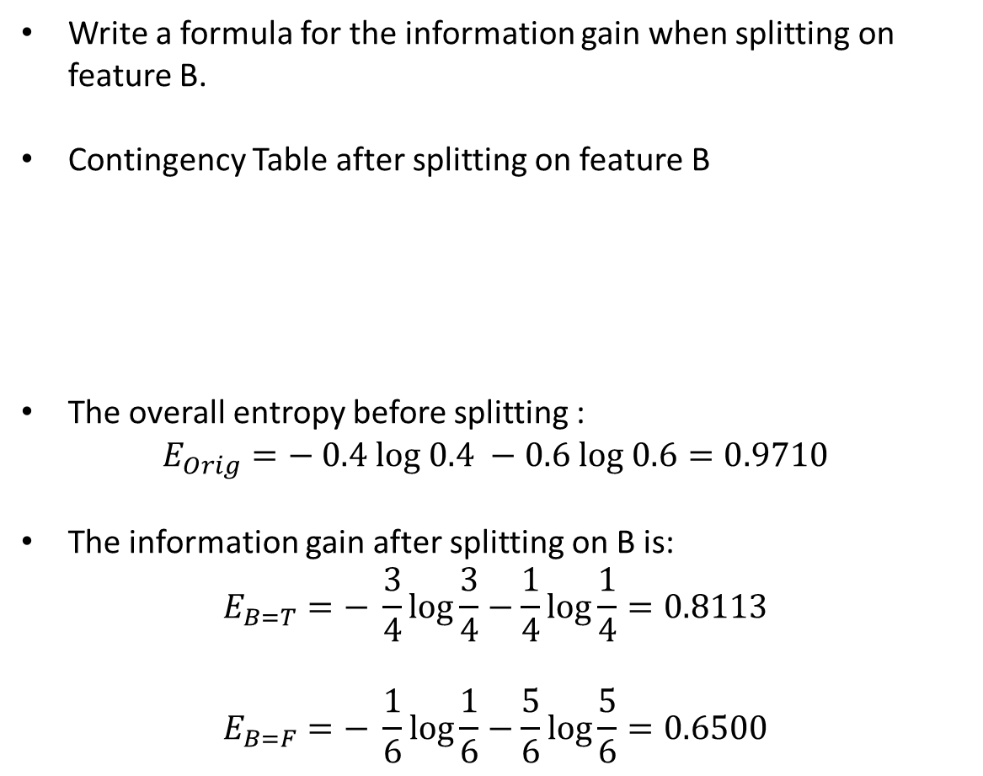

2- Consider the following data set for a binary class problem and consider building a decision tree using this data.
Write a formula for the information gain when splitting on feature B.
Contingency Table after splitting on feature B
The overall entropy before splitting :
$$E_{Orig}=− 0.4 log 0.4 −0.6 log 0.6=0.9710$$
The information gain after splitting on B is:
$$E_{B=T}=− \frac{3}{4}log\frac{3}{4}−\frac{1}{4}log\frac{1}{4}=0.8113$$
$$E_{B=F}=− \frac{1}{6}log\frac{1}{6}−\frac{5}{6}log\frac{5}{6}=0.6500$$
Feature A | Feature B | Class Label
T | F | +
T | T | +
T | T | +
T | F | -
T | T | +
F | F | -
F | F | -
F | F | -
T | T | -
T | F | -
 | B = T | B = F
+ | 3 | 1
- | 1 | 5
$∆ = E_{Orig}− \frac{4}{10}E_{B=T}−\frac{6}{10}E_{B=F}=0.2565$

Slide 6
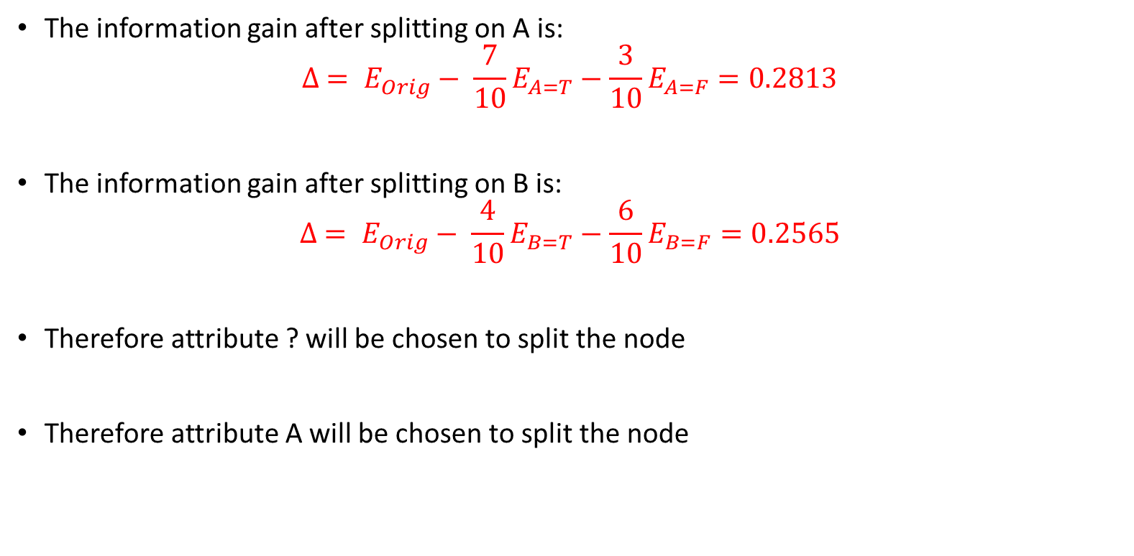
The information gain after splitting on A is:
$$∆ = E_{Orig}− \frac{7}{10}E_{A=T}−\frac{3}{10}E_{A=F}=0.2813$$
The information gain after splitting on B is:
$$∆ = E_{Orig}− \frac{4}{10}E_{B=T}−\frac{6}{10}E_{B=F}=0.2565$$
Therefore attribute ? will be chosen to split the node
Therefore attribute A will be chosen to split the node

Slide 7
3- Consider the following simple dataset: Classify the point x=5.0 according to its 1-, 3-, 5- and 9-nearest neighbors.
x | 0.5 | 3.0 | 4.5 | 4.6 | 4.9 | 5.2 | 5.3 | 5.5 | 7.0 | 9.5
y | - | - | + | + | + | - | - | + | - | -
1-NN: x=5.0 should be classified as ?
3-NN: x=5.0 should be classified as ?
5-NN: x=5.0 should be classified as ?
9-NN: x=5.0 should be classified as ?
+
–
+
–
Notes:
How does the parameter k affect the k-NN classifier? What would be the behaviour as k$→ ∞$?
when there are ties in terms of distance, need some way of handling. Could randomly select one, or select both. For the above question, get same answer using either strategy
Choosing smaller values for K can be noisy and will have a higher influence on the result.
3) Larger values of K will have smoother decision boundaries which mean lower variance but increased bias. Also, computationally expensive.
4) Another way to choose K is though cross-validation. One way to select the cross-validation dataset from the training dataset. Take the small portion from the training dataset and call it a validation dataset, and then use the same to evaluate different possible values of K. This way we are going to predict the label for every instance in the validation set using with K equals to 1, K equals to 2, K equals to 3.. and then we look at what value of K gives us the best performance on the validation set and then we can take that value and use that as the final setting of our algorithm so we are minimizing the validation erro

Slide 8
4- Describe two ways one could use a decision tree to make a classification where the test instance may have missing feature values.
Answer:
Could either i) Impute the missing values and then use the decision tree (the merit of doing this will depend on the accuracy of imputation), or ii) When at prediction time we encounter a node in the decision tree which tests a variable A, and for that variable we have in our instance a missing value than all the possibilities are explored. Thus, for each possible sub-node a prediction is made. We keep the distribution for each sub node and we add them. Finally the class chosen for prediction is the class with the biggest density value.
See also http://uksim.info/aims2015/CD/data/8675a122.pdf

